Slide 1
SenchaCon 2013 Hackathon - BrainStormer
gauravkheterpal
gaurav.kheterpal@metacube.com
Starts at 4:15 PM

Slide 2


Agenda
Quick Intro
BrainStormer - Features
BrainStormer – Tech Stack
Demo & Code Walkthrough
Q&A

Slide 3
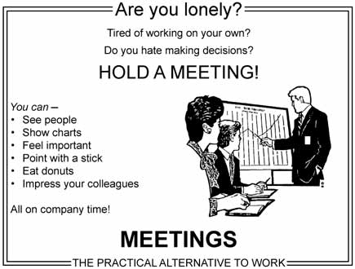
Meetings
Interesting?

Slide 4

Meetings
Boring?

Slide 5
Meetings
Whatever the case may be – there’s ton of valuable info discussed in meetings
So, how do you ensure you don’t lose that?
Presenting BrainStormer!

Slide 6
BrainStormer - Features
Take snapshots of meeting boards
Share notes via email instantaneously!
Edit/ Delete Notes as you want!
Attach hand-drawn annotations, highlighting*

Slide 7
BrainStormer – Tech Stack
Technology Stack
Sencha Touch 2.2
Cordova Camera Plugin
PhoneGap Build Tool

Slide 8
Supported Platforms
Android
iOS
BlackBerry 10*

Slide 9
BrainStormer – What’s Next
If wishes were horses, if pigs could code and developers could fly
Evernote Integration
Salesforce Chatter Broadcasts

Slide 10
Demo & Code Walkthrough
Code - https://github.com/mcube/SenchaCON-Charts-demo
Live Demo - http://174.129.42.247/SenchaCONDemo/
Building BrainStormer for me was ‘Serious App Dev, Serious Fun’

Slide 11

Q&A
We worked very hard to make BrainStormer, here’s what we plan to do next ☺

